Slide 1


Elevating Global Biosecurity through International Standards
IBBIS event, 6 November 2025, Singapore
Ayelet Berman, LLB, PhD
Visiting Associate Professor
Asia Centre for Health Security
National University of Singapore

Slide 2
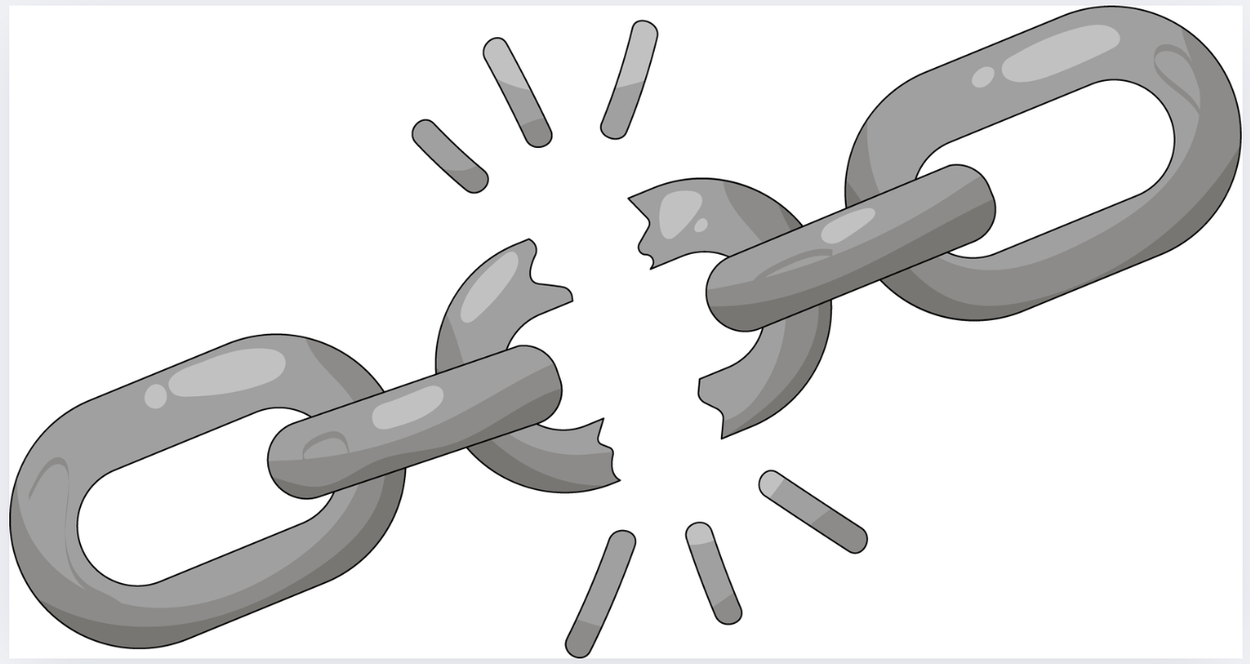
Innovation in biotechnology is only as secure as its weakest link

Slide 3

Agenda
Setting the Stage: Why Biosecurity of Synthetic Nucleic Acids Matters
Current Regulatory Landscape: Screening Practices and Gaps
The Case for International Standards
Comparing Frameworks: ISO 20688-2 vs. IGSC Harmonized Screening Framework
Advantages of ISO Standards for Global Alignment
Implementation Pathways: Integrating ISO Standards into National and International Frameworks

Slide 4
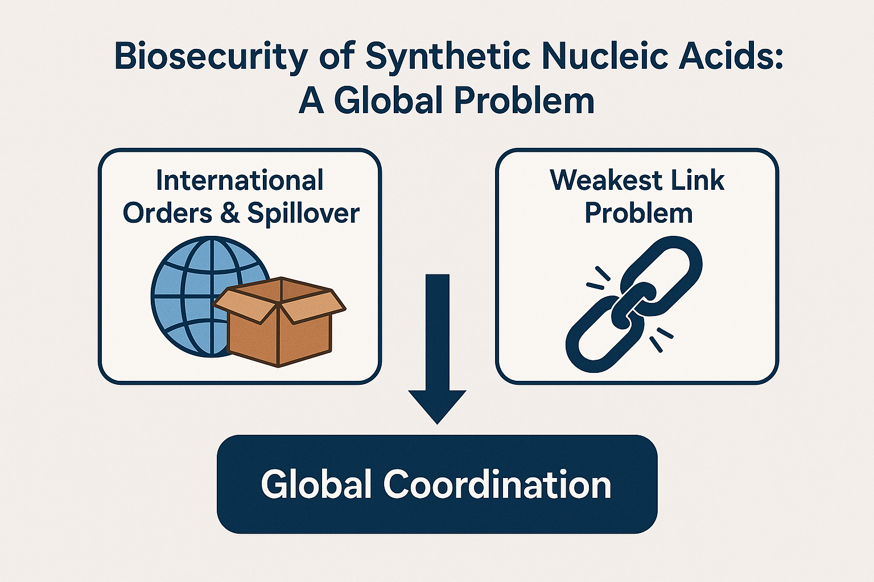
Setting the Stage: Why SNA Biosecurity Matters
Rapid growth of synthetic biology and global SNA trade
Biosecurity and dual-use risks (e.g., pathogenic sequences, unverified orders)
Global spill-over risks
The weakest-link problem: one unregulated provider undermines all others (Examples from COVID-19, the 2008 financial crisis)
Limits of current legal and regulatory frameworks (BWC, export controls, select agent rules)
As synthetic biology expands, innovation and security must evolve together

Slide 5
Current Regulatory Landscape & Gaps
International: BWC – silent and requires clarification
National:
  Country select agent and export control laws
  Country guidance (U.S., U.K.)
Private: Voluntary screening by industry (IGSC)
Standardization: ISO 20688-2
Despite multiple instruments, no coherent global baseline exists.

Slide 6
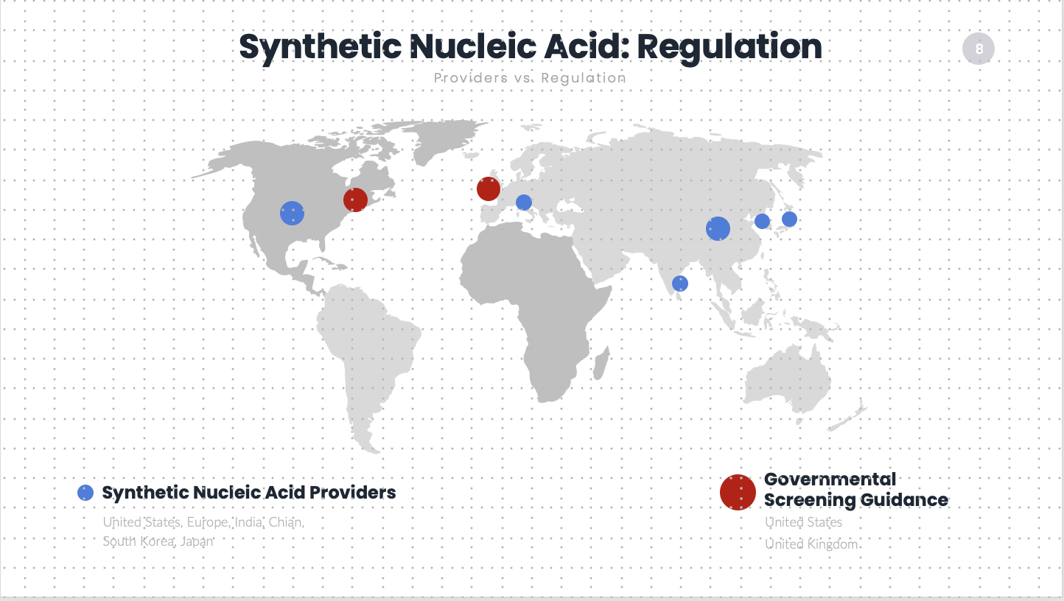

Slide 7

The Case for International Standards
SNA Features
“Problems without passports require solutions without borders”: National measures alone are insufficient for global problems
Weakest Link problem
International standards can:
Set a minimum biosecurity baseline
Reduce regulatory arbitrage
Reflect accountability across jurisdictions and supply chains
Benefits
For the public: Better biosecurity
For industry: Level playing field for industry
For regulators: Better information exchange among regulators and actors
Precedents from other sectors (aviation safety, AML, financial standards)

Slide 8
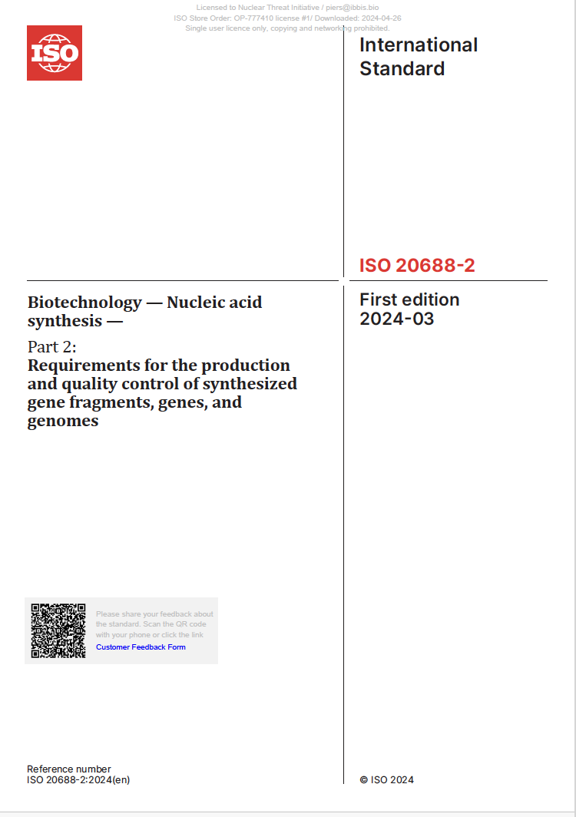
International Standards

Slide 9
Comparing ISO and IGSC Standards
Aspect | ISO 20688-2 Standard | IGSC Harmonized Screening Framework
Legitimacy | Very high formal legitimacy; consensus-based; Open to national standards bodies from 160+ countries | Practical legitimacy; yet limited formal legitimacy. Lacks ISO standing, Membership-driven; limited participation from LMICs or non-commercial actors
Institutional Recognition | Referenced in legislation, procurement, and regulatory guidance | Informally Informed U.S. and U.K. government guidance and ISO 20688-2 design
Adoption Potential | VOLUNTARY Broader — can be adopted directly into domestic frameworks or referenced in regulation. Can become BINDING. | VOLUNTARY Companies
Technical Authority | High-level framework; lacks operational granularity (e.g., database/algorithm guidance) | Strong — informed by industry experience and operational realities
Practical Uptake | Limited — few providers/countries have operationalised it | High — widely implemented by major providers
Legality / WTO Compliance | Aligns with WTO TBT Agreement — use of ISO standards provides presumption of non-discrimination and compliance with international trade law | Not recognized under WTO law; no presumption of legality or trade consistency

Slide 10
Advantages of ISO Standards
Formal legitimacy: broad global membership, consensus-based
Legal implementation: ISO standards are widely used as the technical backbone of legal and regulatory systems. Commonly adopted or incorporated into
national law
international treaties (e.g., ICAO, IMO, Codex)
Binding: Through integration into national or international law it can become binding
Legal compatability: Complies with international trade law TBT Agreement)
Technical: Absolves governments of the need to develop the technical guidance by themselves.

Slide 11
Implementation Options
🏛️ National
Referencing ISO standard in the national regulation
Incorporating procurement, grant or licensing requirements
Note: A country may reference the ISO standard through soft law instruments like ministerial guidance, national biosafety codes etc., that is, also without an updated select agent law, but not anchoring the standard in binding legislation will undermine enforceability and can create fragmentation.
🌍 International/Regional
Integrating into BWC or other international initiatives, e.g., Australia Group, CEPI (precedents in other sectors (TBT Agreement)
🧬 Industry
Facilitates compliance with Export controls /select agents /procurement demands
Participate in harmonization efforts

Slide 12
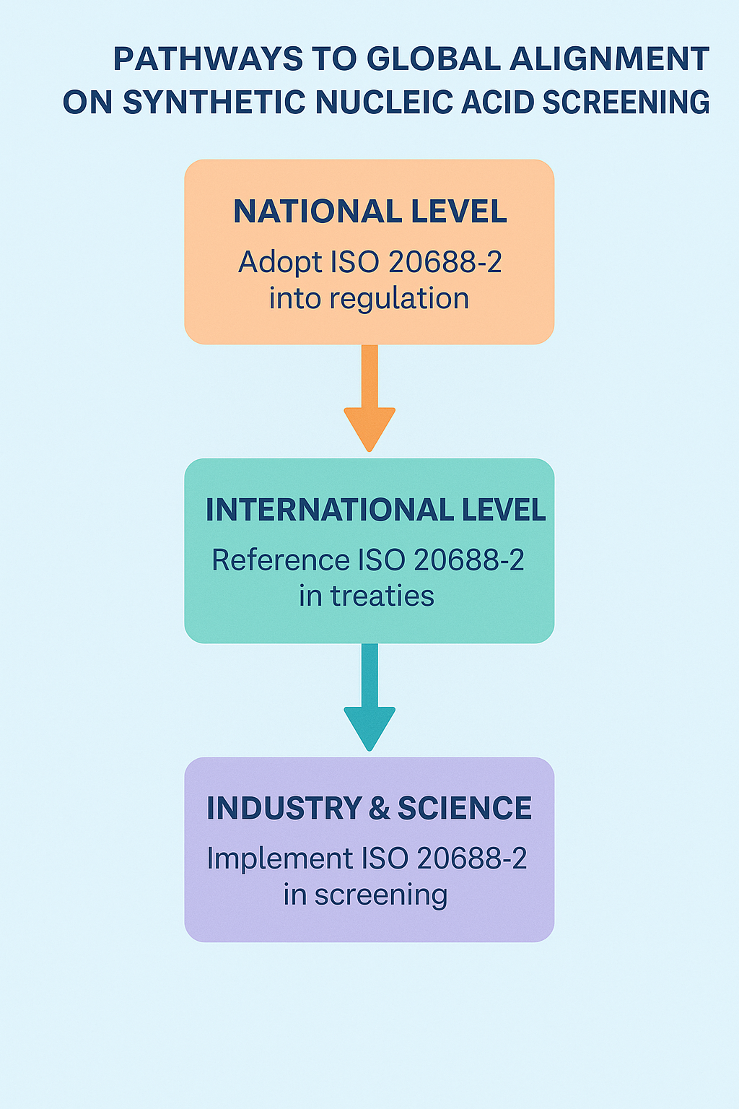

Slide 13
Summary
Screening is the cornerstone of safe synthetic biology: it is the only practical safeguard against the accidental or deliberate synthesis of harmful sequences.
Regulatory Fragmentation: Oversight of synthesis of nucleic acids remains uneven and limited.
Weakest-link risk: Inconsistent global adoption undermines global health security; one unscreened provider can compromise the entire global health security system
Private industry standards are not enough: IGSC frameworks provide valuable experience, but lack legal enforceability and global inclusiveness.
ISO standards offers a pathway: They provide formal legitimacy, compatibility with WTO law, making them suitable for incorporation into national and international regulation.

Slide 14

Questions and answers

Slide 15

Stay in Touch
Stay in touch
ayelet@ayeletberman.com
Connect with me on LINKEDIN

