Slide 1


International Regulatory Alignment
Nucleic Acid Synthesis Screening
Ayelet Berman
Visiting Associate Professor
Asia Centre for Health Security
National University of Singapore

Slide 2

Agenda
Why International Regulatory Alignment Matters
International Alignments: Role and Benefits of International Standards
Current Regulatory Landscape and Gaps
Why is Alignment Difficult?
Building Blocks for Alignment

Slide 3
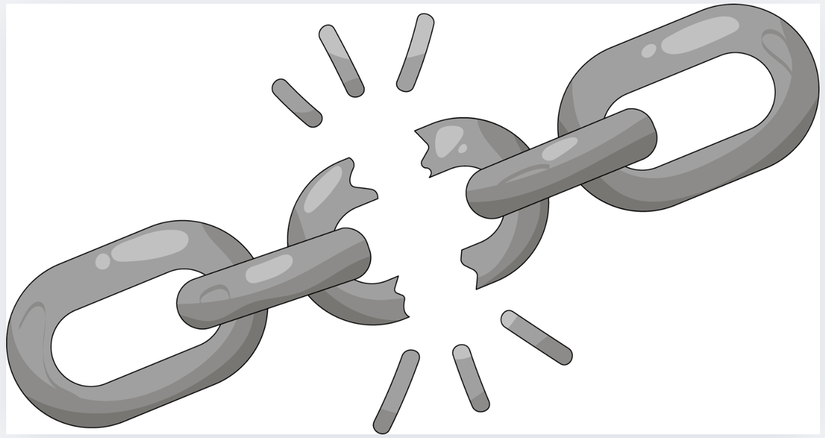
Why International
Regulatory Alignment Matters
Rapid growth of synthetic biology and globalized SNA trade
Biosecurity and dual-use risks (e.g., pathogenic sequences, unverified orders)
Global spill-over risks
The weakest-link problem: one unregulated provider undermines all others (Examples from COVID-19, the 2008 financial crisis)
Limits of current legal and regulatory frameworks (BWC, export controls, select agent rules)
Problems without passports require solutions without borders

Slide 4

International Alignments: Role and Benefits of International Standards
Set a minimum biosecurity baseline
Reduce regulatory arbitrage
Reflect accountability across jurisdictions and supply chains
Benefits
For the public: Better biosecurity
For industry: Level playing field for industry
For regulators: Better information exchange among regulators and actors
Precedents
Aviation safety (ICAO), AML (FATF), financial standards (Basel Committee), pharmaceuticals (ICH)

Slide 5
Current Regulatory Landscape and Gaps Landscape & Gaps
International:
  BWC -- silent and requires clarification
  UNSCR 1540
  IHR/Pandemic Agreement
National:
  Country select agent and export control laws (limited scope for SNA)
  Country guidance (U.S., U.K.)
Private/technical standards:
  IGSC
  ISO 20688-2
  EBRC Best Practices?
Despite multiple instruments, no coherent global baseline exists, and no oversight

Slide 6
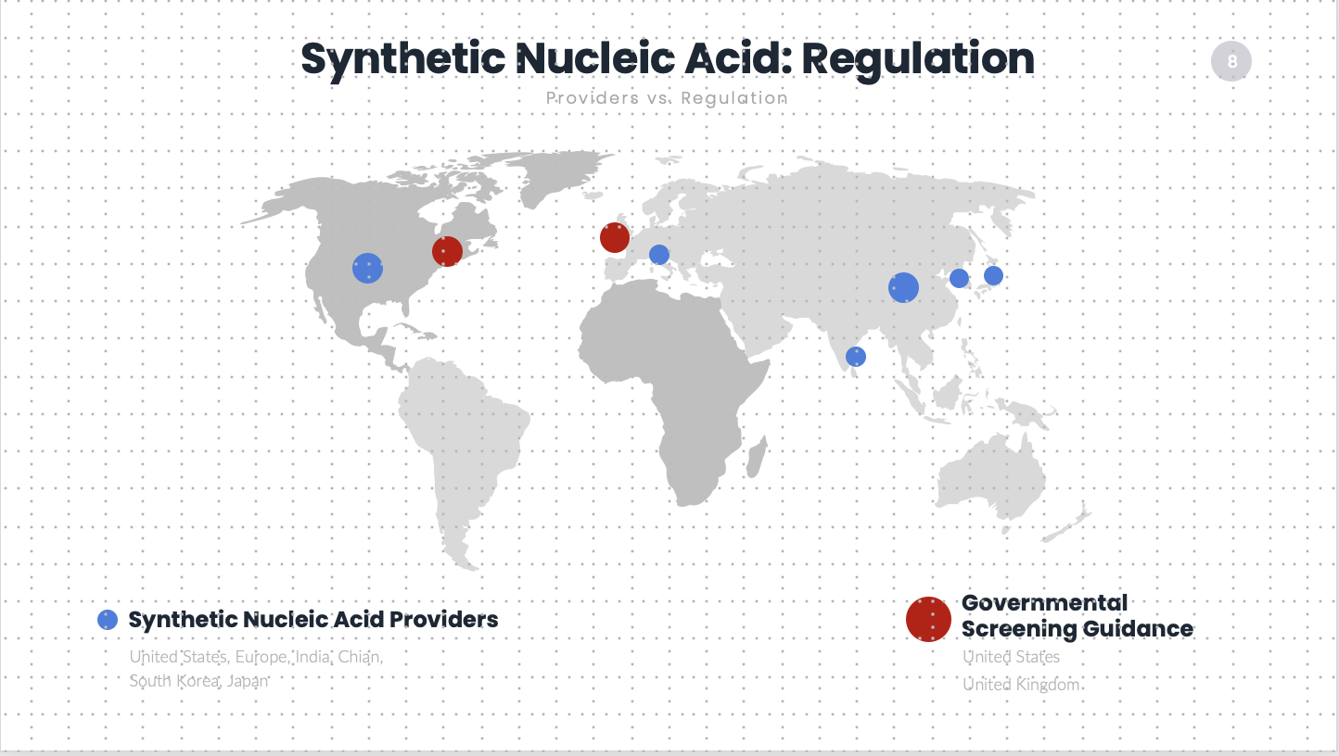
Notes:
Global SNA market
Only two countries have screening requirements
A word on biosecurity laws:
Most countries do not have any framework.
Some countries do have a framework, which is composed of select agent laws, export controls and anti terrorism laws. I am generalizing for the sake of the discussion to describe a trend.
Only very few countries mention SNA in their select agent laws. EXPORT CONTROL laws of Australia Group members do cover SNA of listed pathogens, but do not cover sequences of concern.
To comply with these laws that mention SNA – companies need to screen. But as said, most countries do not have screening guidance. Only two countries have screening guidance. Also, gap between domestic transfer and export.
Bottom line: Major regulatory variations between countries, as well as within countries!

Slide 7
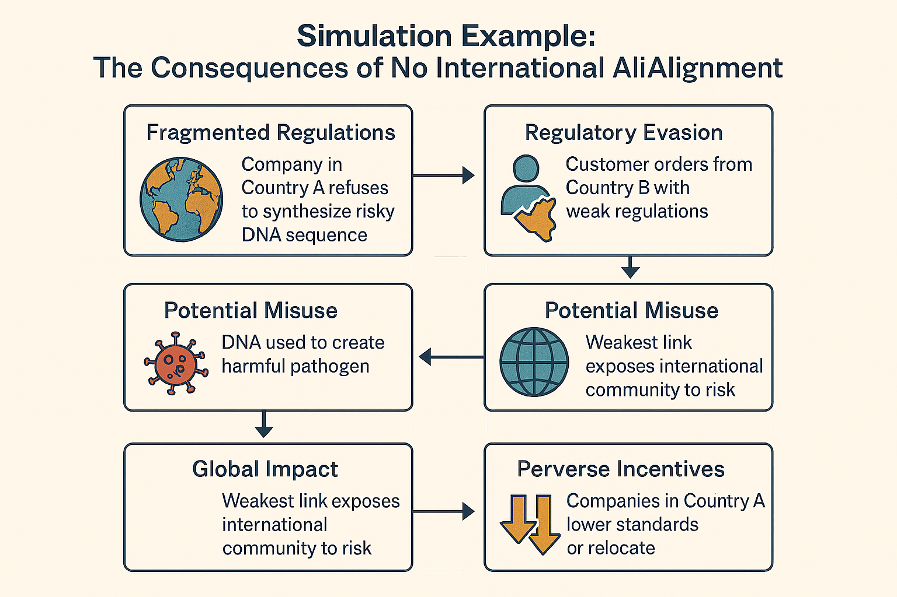
Notes:
Without coordinated international standards, the system becomes fragmented and vulnerable. This not only increases the risk of misuse but also discourages responsible screening, as companies and countries may prioritise competitiveness over safety
Simulation Example: The Consequences of No International Alignment
Scenario:
Imagine a world where countries have different biosecurity regulations for synthetic nucleic acids. Some countries have strict screening and oversight, while others have minimal or no controls.
Step-by-Step Misuse:
Fragmented Regulations:
A company in Country A (with strict regulations) refuses to synthesise a potentially risky DNA sequence for a customer, following national biosecurity guidelines.
Regulatory Evasion:
The customer, determined to obtain the sequence, simply places an order with a synthesis company in Country B, where regulations are weak or non-existent.
Unscreened Synthesis:
The company in Country B, facing no legal requirement to screen orders, synthesises and ships the DNA sequence without any checks.
Potential Misuse:
The DNA sequence could be used to create a harmful pathogen, either intentionally (bioterrorism) or accidentally (lab leak). The consequences are not limited to Country B—pathogens do not respect borders.
Global Impact:
The initial efforts of Country A to protect public health are undermined. The weakest link (Country B) exposes the entire international community to risk.
Perverse Incentives:
Companies in Country A may feel pressured to lower their standards or relocate to Country B to remain competitive, further eroding global biosecurity.

Slide 8

Why is Alignment Difficult?
Achieving alignment is as much a political and economic challenge as a technical one
Priorities: Awareness and Diverse Political Saliency
Legal: Fragmented and Varied National Frameworks
Political: Reaching a multilateral agreement is difficult
Economics: Capacity gaps and economic disincentives
Technical: Data governance – SOC databases

Slide 9
Building Blocks for Alignment
Sustained governmental and non-state actor leadership will be needed to achieve alignment

Slide 10
Building Blocks for Alignment
International
Use BWC and other forums to advance alignment
Transgovernmental clubs: Use existing (Australia Group, NATO, OECD) or establish new ones to set de facto global standards. For example: Basel Committee for Banking Supervision, FATF
Use ISO for standard setting due to universal legitimacy, global reference in national and international laws, and compliance with WTO law

Slide 11
Building Blocks for Alignment
National
Adopt ISO or other international standards
Mutual recognition programs
Using Market leverage
Market Access Rules like EU -GDPR
Procurement rules

Slide 12
Building Blocks for Alignment
Non-state actors
Funders: Screening provisions in contracts
Industry: Adopt international standards

Slide 13
Summary
Fragmentation undermines collective biosecurity.
Alignment strengthens global health security.
Achieving regulatory alignment remains challenging — political, technical, and economic barriers persist.
Existing international standards are primarily private, limited in scope, or lack enforcement.
International alignment will require governmental leadership and commitment, in collaboration with non-state actors.

Slide 14

Questions and answers

Slide 15
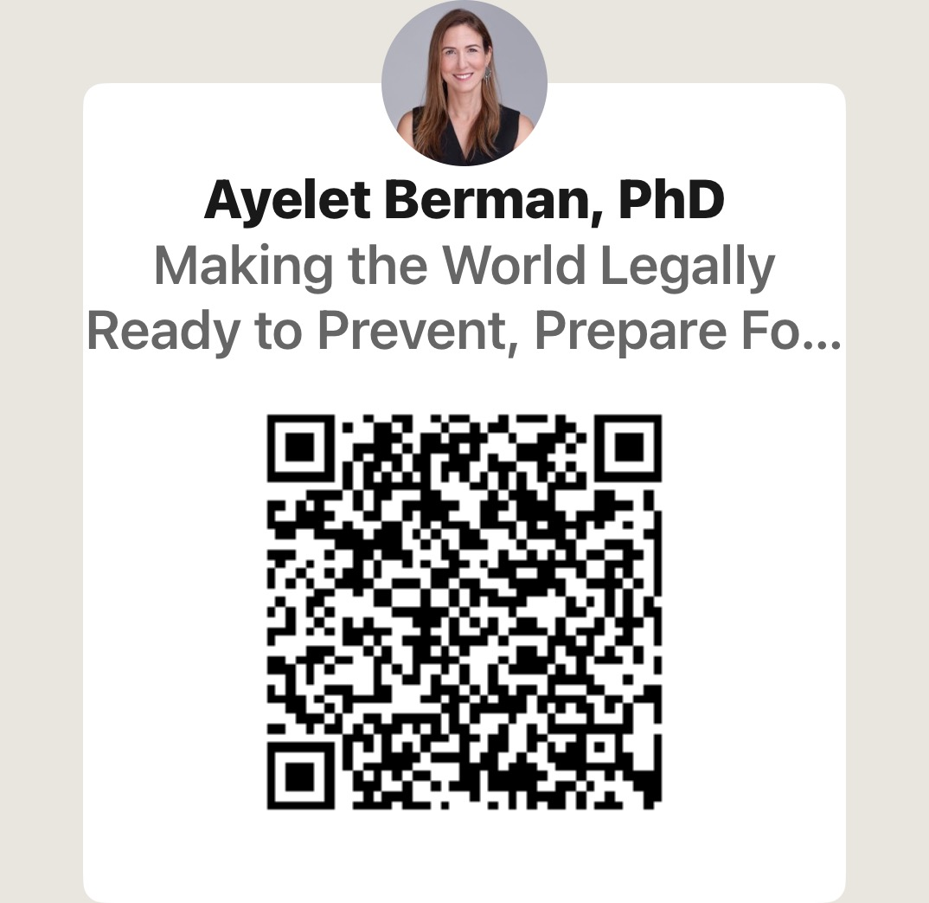
Stay in Touch
Stay in touch
ayelet@ayeletberman.com
Connect with me on LINKEDIN

